Slide 1

2023 INTERNSHIP PROJECT
REPORTING CYCLE: Jan – May 2023
PRESENTED BY: Group 1

Slide 2
Team Members
Group 1
Funmilayo Raphael - Team Lead
Rotimi Olatunde Fawumi

Slide 3
Sections
ANALYSIS TOOLS
ANALYSIS PROCESS
TERMINOLOGY
KEY PERFORMANCE INDICATOR
RECOMMENDED BENCHMARK
TEAM MEMBERS
OVERVIEW
ANALYSIS
KPIs
GAP ANALYSIS OVERVIEW
RECOMMENDATION
CONCLUSION
APPENDIX
PROBLEM STATEMENT

Slide 4
Data Collection And Analytics Tools
ONE DRIVE
GOOGLE ANALYTICS USER TECHNOLOGY DATASET
2. MICROSOFT POWER BI
1. MICROSOFT EXCEL
SLACK

Slide 5
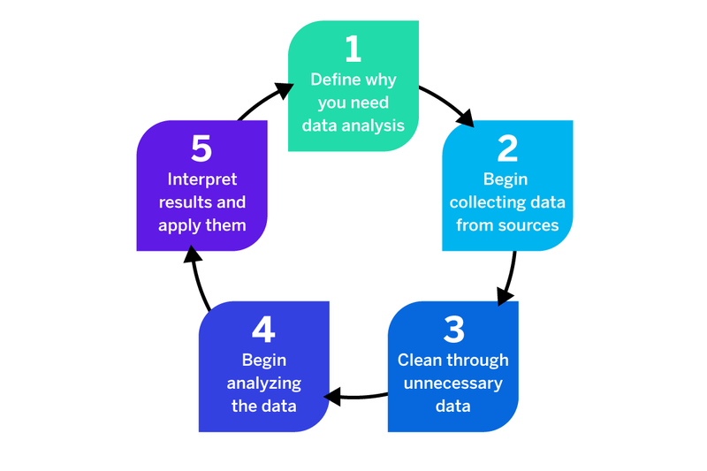
Analysis Process

Slide 6
TERMINOLOGIES | DEFINITIONS
Browser(Mobile and Desktop) | The browser from which user activity originated. Typical browsers include 'Chrome', 'Edge', 'Firefox', 'Internet Explorer', 'Opera', and 'Safari’ which can either be on mobile or pc.
Average Engagement Time | The average time that your website was in focus in a user's browser, or an app was in the foreground of a user's device. Average engagement time = total user engagement durations / number of active users
Conversions | The number of times users triggered a conversion event.
Engaged Sessions | The number of sessions that lasted 10 seconds or longer or had 1 or more conversion events or 2 or more page or screen views.
Event Count | The number of times users triggered an event.
Engaged Session per User | The average number of engaged sessions per user. Engaged sessions is the number of sessions that lasted 10 seconds or longer or had 1 or more conversion events or 2 or more page or screen views.
Engagement Rate | The percentage of sessions that were engaged sessions. Engagement rate = engaged sessions / total sessions
New User | The number of new unique user IDs that logged the first open or first visit event. The metric allows you to measure the number of users who interacted with your site or launched your app for the first time.
User | The number of distinct users who visited your website or application. A user is any user who has an engaged session or when Analytics collects
Conversion Rate | The percentage of conversion events that were triggered out of the event counts. Conversion rate = conversion/event count
Bounce Rate | The percentage of unengaged sessions. Bounce rate = unengaged sessions / total sessions

Slide 7
Key Performance Indicators
TOP 3 BROWSERS BY NEW USERS
1
TOTAL USERS ACCESSING THE WEBSITE BY BROWSER
2
TOP 3 BROWSERS WITH THE LEAST ENGAGEMENT SESSION
3
COMPARE THE ENGAGEMENT RATE BY BROWSER
4

Slide 8
Recommended Benchmark
Engagement Rate = minimum of 70% of Desktop and 80% of Mobile users
Average Engagement Time = Minimum engagement time 0f 60sec with optimum conversion
Bounce Rate = minimum of 20-30%. it should be introduced for tracking, performance, optimization, and feedback on the webpage.
Conversion Rate = minimum of 10% of desktop and 15% of Mobile users.

Slide 9

Overview of Digital Echoes’/Clients’ Google Analytics Ads
Google Analytics collects data from websites and apps to create reports that provide insights into business.
You can use reports to monitor traffic, investigate data, and understand users and their activities.
11 types of browsers were used to visit Digital Echoes’/Clients’ website over the course of 5 months(Jan-May).
There are 2 types of users; existing users and new users.

Slide 10

Problem Statement
Digital Echoes (or Client) is currently facing a challenge in understanding the factors influencing the variability in low conversion rates.
To address this issue, we hypothesise that the effectiveness of their marketing strategy significantly impacts the number of conversions generated.
This hypothesis will be tested through a comprehensive analysis of historical data and the implementation of targeted strategies to improve conversion rates.
The findings aim to provide actionable insights to enhance the overall performance of conversion rate.
Notes:
Hypothesis:
"Is the number of conversions generated significantly influenced by the effectiveness of our marketing strategy during the specified time period?"
Objective:
To conduct a thorough analysis of historical data and implement targeted strategies, aiming to uncover insights that will improve overall conversion rates.

Slide 11
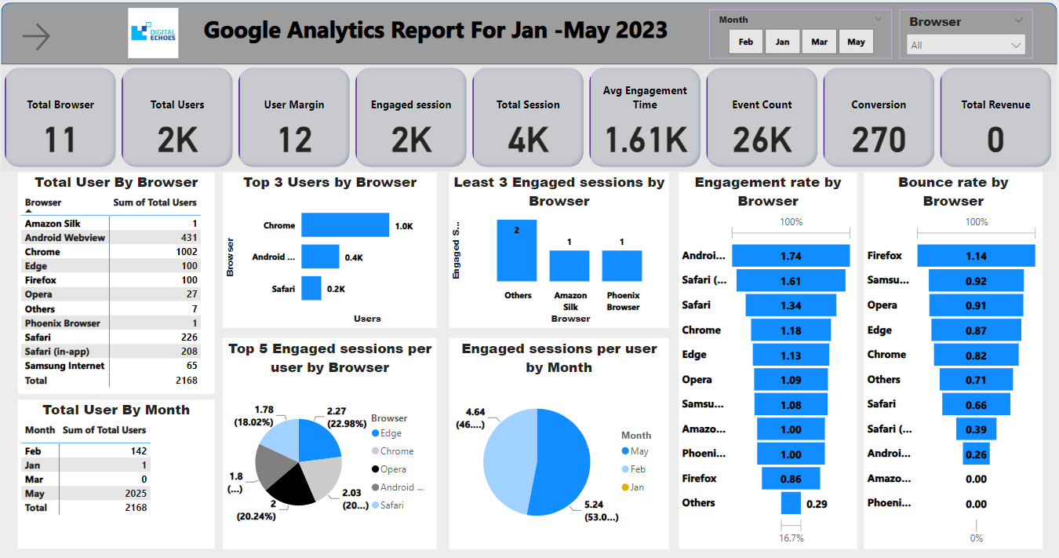

Slide 12
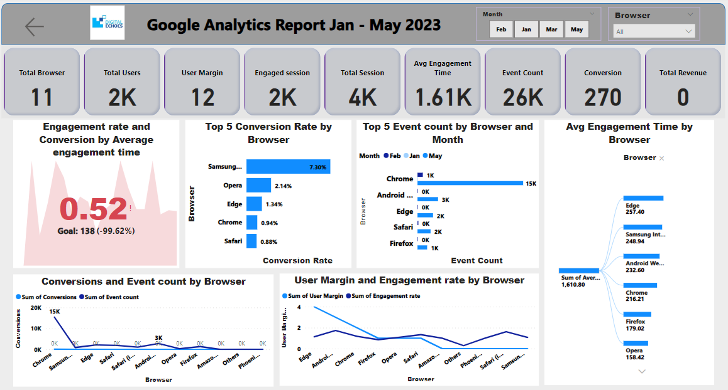

Slide 13
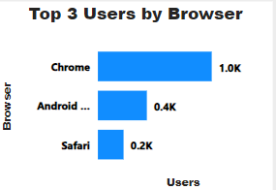
KPI 1: Top 3 Browser By New User
From the period under review:
Chrome has the highest number of users, with a total number of 1002, followed by Android and Safari with 431 and 226 respectively.
Chrome users account for about 50% of total users.

Slide 14
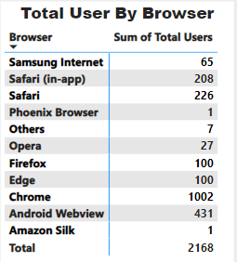
KPI 2: Total Users By Browser
From the table, the browsers with the top 3 users are Chrome, Android, and Safari with 1002, 431 and 226 respectively while the browsers with the least 3 users are Amazon Silk, Phoenix browser, and others with 1, 1, and 7 respectively.

Slide 15
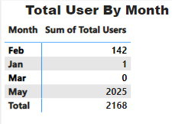
KPI 3: Total Users By Month
The table shows user distribution by month, the month of May had 93.4% users while February accounted for just 6.5%.
Users for the month of January and March were negligible while the month of April had no users.

Slide 16
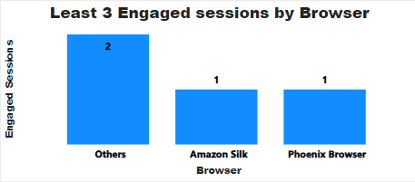
KPI 4: Top 3 Browser with the Least Engagement Session
From the period under review:
Phoenix browser and Amazon Silk had the least number of engagement sessions with just a unit engaged session each.

Slide 17
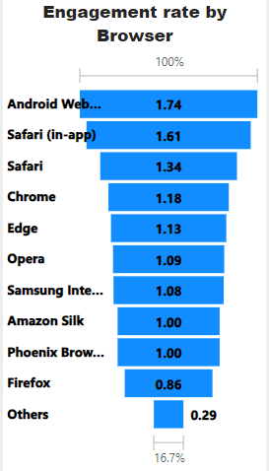
KPI 5: Engagement Rate by Browser
From the Jan-May, Android and Safari(in-App) had the highest engagement rate which was 1.74 and 1.61 respectively.
The browsers with the lowest engagement rates were firefox and others which were 0.86 and 0.29 respectively.
It was observed that mobile browsers users have a higher engagement rate than desktop browser users considering the data under review.
The average engagement rate was 1.12.

Slide 18
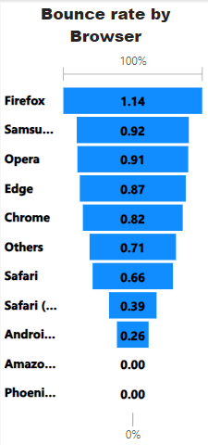
KPI 6: Estimated Bounce Rate by Browser
From the Jan-May, Samsung internet and Opera had the highest Bounce rate which was 0.92 and 0.91 respectively.
The browsers with the lowest Bounce rates were Chrome and Safari which were 0.82 and 0.66 respectively.
It was observed that the browsers have a high bounce rate of an average of 60.7% considering the data under review.
The average estimated rate was 0.61.
Source: Power BI

Slide 19
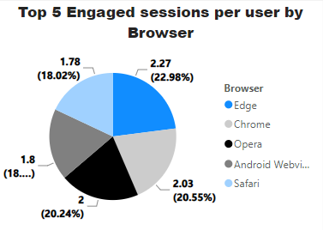
KPI 7: Total 5 Engaged Sessions per User by Browser
3 browsers (Edge, Chrome and Opera) accounted for 65% of the total engaged sessions per user.
Safari is the least browser with 18.02% engagement session per person of the top 5 browsers.

Slide 20
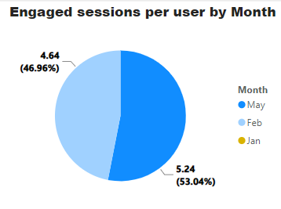
KPI 8 :Engaged Sessions per User by Month
May account for more than 50% (specifically 53.04%) monthly engaged session per user while Feb account for slightly less than 50% ( precisely 46.96%)
The 3 other months ( Jan, Mar, and Apr) left are negligible with a combined percentage of 0%
The data was skewed and largely dependent on the month of May as well as Feb data.

Slide 21
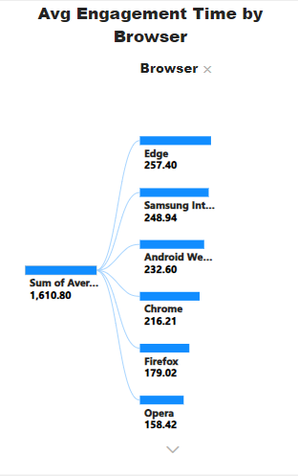
KPI 9: Average Engagement Time by Browser
From the period under review:
The browsers with the highest average engagement time are Edge, Samsung Internet, Android Web view, and Chrome with their respective values of 257.40, 248.94, 232.60, and 216.21 seconds respectively
The browsers with the lowest average engagement time are Safari (in-app), others, and Amazon Silk with 86.11, 4.29, and 3.00 seconds respectively
It was observed that users tend to spend more time on mobile browsers than on desktop browsers which could translate to more conversions

Slide 22
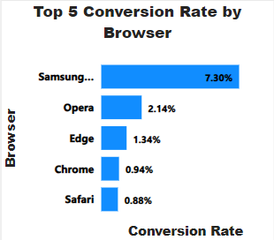
KPI 10: Top 5 Conversion Rate by Browser
The chart shows the rate of conversion triggered by the conversion event count. The data shows that Samsung had close to 8%, which is almost twice the rest of the browsers in the top 5.
It indicates that more attention should be given to mobile users to have more conversions.
A higher Event Count does not guarantee more conversions, bounce rate calculation could be a suitable metric that could correct the flaws of the low conversion rate.
Bounce rate =( [total session-engaged session]/Total session)*100%
Bounce rate = ([4000-2000]/4000)*100 = 50%
Calculated bounce rate = 50%

Slide 23
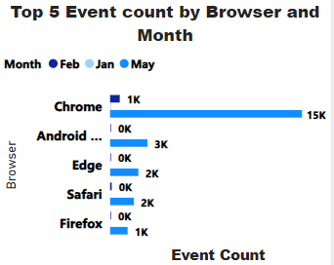
KPI 11: Top Event Count by Browser and Month
The chart shows that Event Counts distribution was triggered mostly in May with Chrome having 15,000 Event Counts while others and Amazon Silk are the lowest with 4 Event Counts only.
Also, the chart shows that Chrome had the highest Event Count of approximately 1,000 in Feb.
The relationship between Event Count and Conversion rate is inverse, while the average engagement time shows a direct relationship.

Slide 24
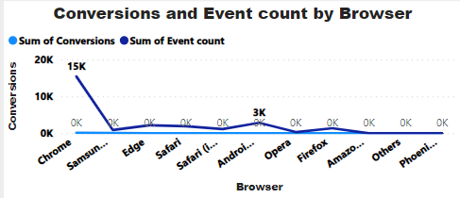
KPI 12: Conversions and Event Count by Browser
There is an inverse relationship between the total number of triggered Event Counts and Conversion Rate.
Chrome and Android account for 15,000 and 3,000 Event Counts respectively compared to the conversion that is nearly zero across all browsers.
The negative correlation between Event Counts and Conversion rate is likely the cause of zero Revenue, though the website may not have been marketized to receive payment digitally.

Slide 25
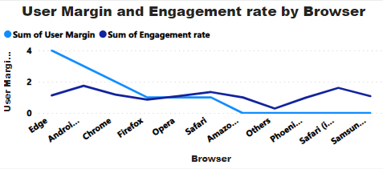
KPI 13: User Margin and Engagement rate by Browser
The data shows that the Engagement Rate was largely dependent on new users with close margins across all browsers.
The total existing users is just 12 out of the total users of 2168. This implies a total of 2156 new users from Jan- May, which is 99.4%.
The interpretation of this is that the ads are generating traffic to the page regularly, however, the challenge was with the page itself. It was not properly optimized for conversion and retention.

Slide 26
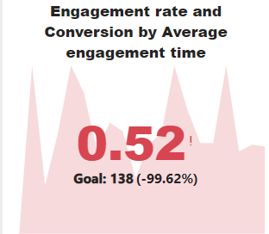
KPI 14: Conversion Target and Goal setting
The overall conversion is -99.62% with an Engagement rate of 0.52 while the average engagement time trend is tracked to monitor the conversion goal targets.
All necessary KPIs and benchmarks must be set to be able to achieve positive conversion goals. KPIs and Benchmarks such as Bounce Rate, Average Engagement Time, Engagement rate, and Event Counts with defined relationships to achieve a positive conversion.
Red: Negative
Green: Positive
Yellow: Neutral

Slide 27

GAP ANALYSIS OVERVIEW
Key Insights:
Product/Service Type
Essential for proper benchmarking.
Ads Channels & Metrics
Utilise email, social media (Instagram, Facebook, TikTok), YouTube, Newsletter for market understanding and optimization.
3. Browser Distribution
Analyze mobile vs. desktop for customer behavior, ad channels, and landing page optimization.
4. User Demography
Target ads based on gender, age, region for optimized conversion growth.
5. Landing Page Engagement
Analyze pages vs. Event Counts for effective engagement rate and sessions.
6. Bounce Rate Impact
Address bounce rate for improved conversions, site issues, and enhanced Google ranking.
7. Revenue Generation Clarity
Determine digital integration or offline collection to assess revenue concerns.

Slide 28
RECOMMENDATIONS
Address Data Gaps
Immediate resolution for critical analysis and accurate forecasting.
Integrated Marketing Campaign
Recommend new campaign aligning ads and webpage management for effective lead conversion and retainment.
Optimize Webpage for User Experience
Ensure responsive design for seamless user experience on mobile and desktop.
Bounce-Off Analysis
Properly analyze bounce off points for content, user experience, layout, or copywriting issues resolution.
Implement Feedback Systems
Introduce questionnaires, surveys, and feedback reviews for customized webpage enhancements.
Landing Page Optimization
Ensure a catchy, engaging, and user-friendly landing page catering to all demographics.
Streamlined Conversion Process
Simplify call to action to minimise event hop count and prevent users' disengagement.

Slide 29
CONCLUSION
The webpage exhibits a notably high overall bounce rate, estimated at 50-60.7%, indicating a substantial portion of sessions lacking engagement. This elevated bounce rate poses a significant hurdle to addressing the conversion rate challenge.
In summary, the webpage appears insufficiently optimized for conversion, despite boasting an impressive overall engagement rate of 112%. The concerning bounce rate range, particularly at 60.7%, strongly correlates with lower conversion rates.
Although lead traffic stands at a commendable 99.4%, the nearly non-existent conversion and retention highlight a critical issue. To effectively resolve this, bridging the identified gaps with precise data is essential for in-depth analysis and problem resolution.

Slide 30


Slide 31

QUESTIONS?

Slide 32
APPENDIX

Slide 33
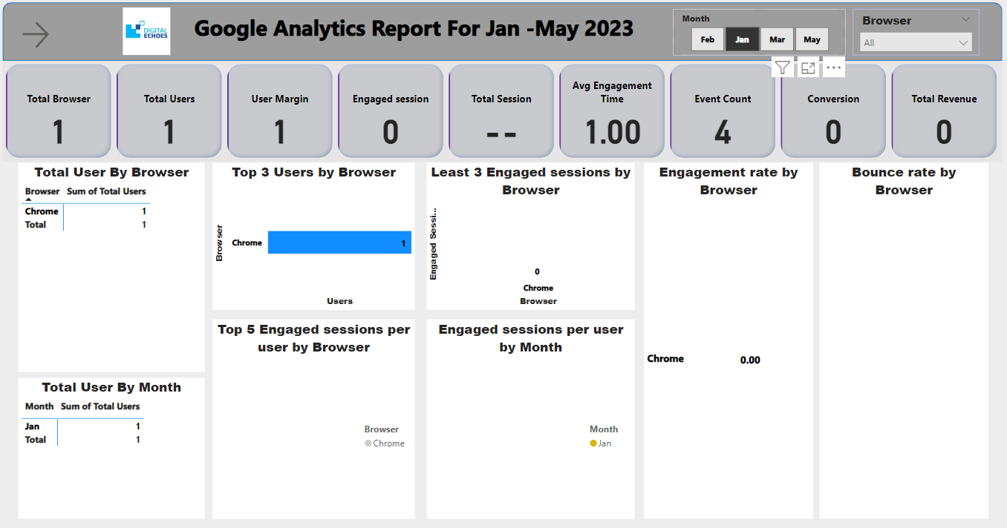

Slide 34
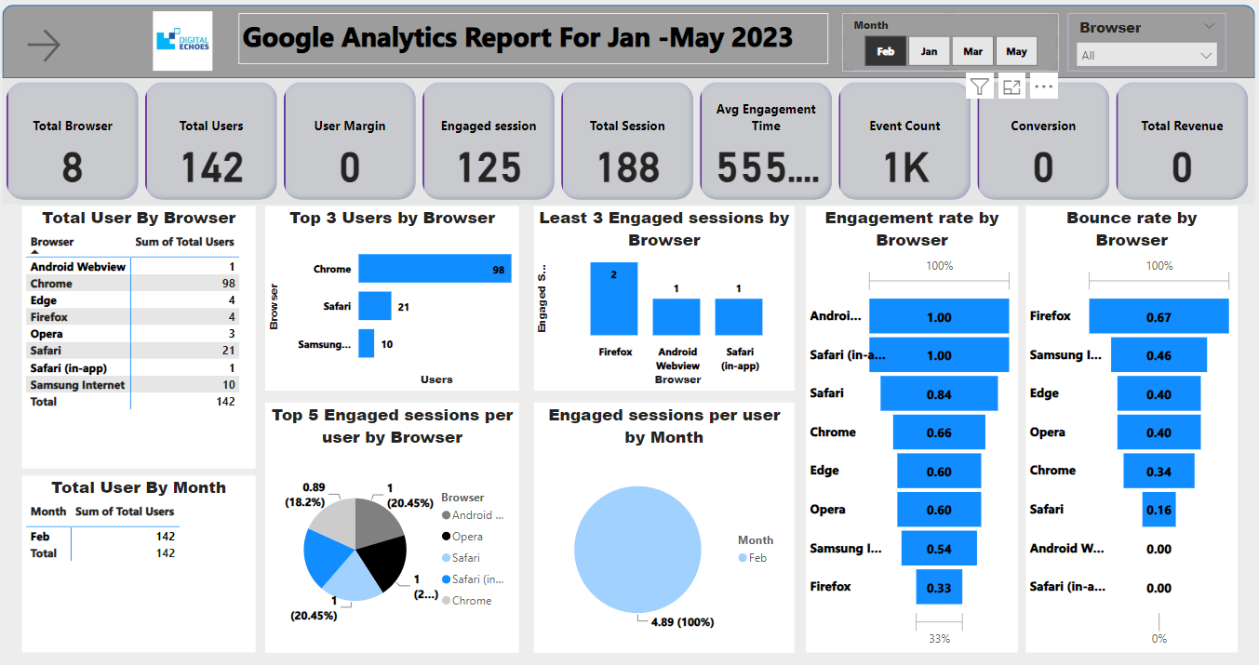

Slide 35
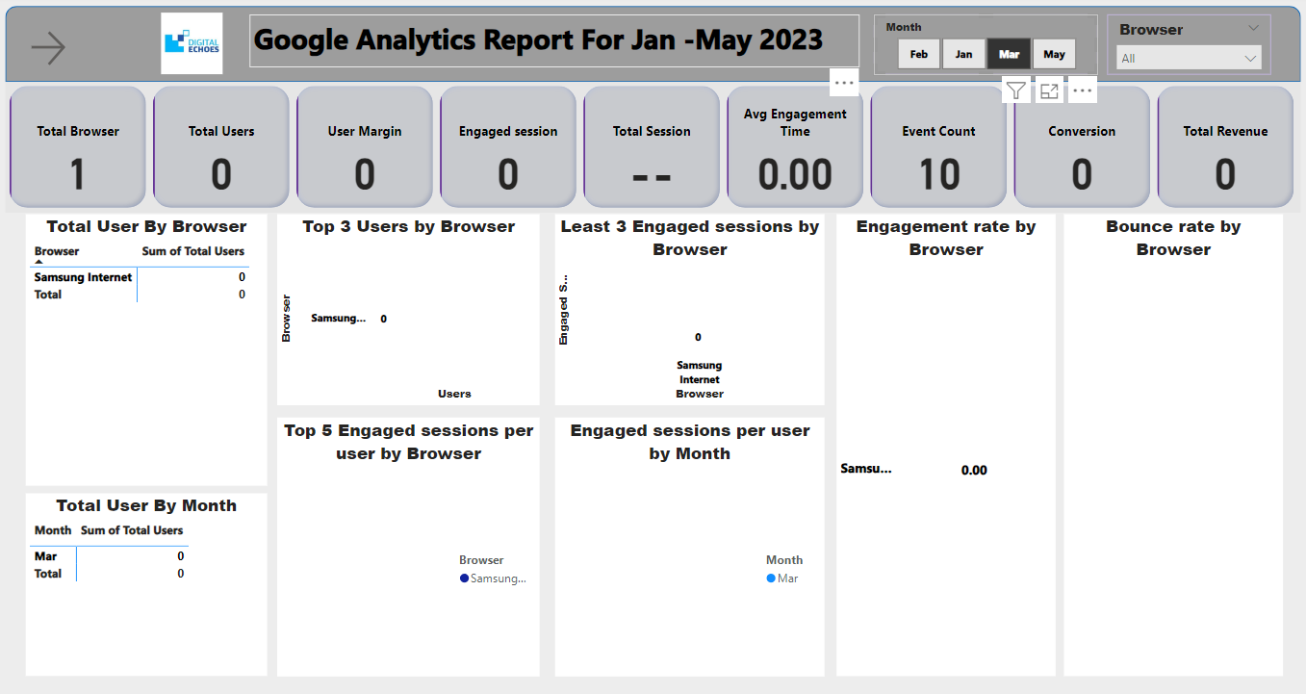

Slide 36
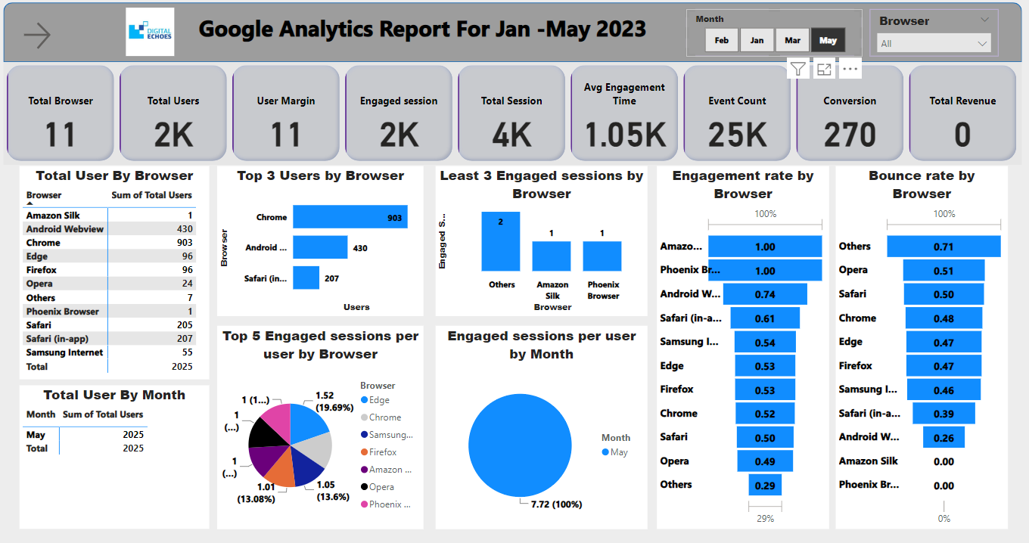

Slide 37
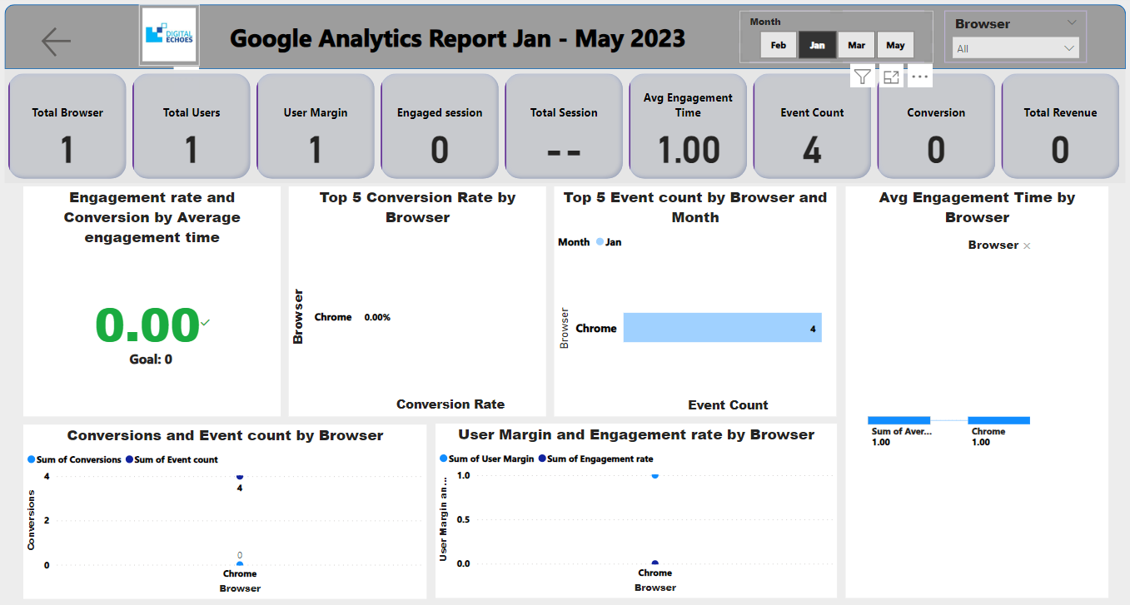

Slide 38
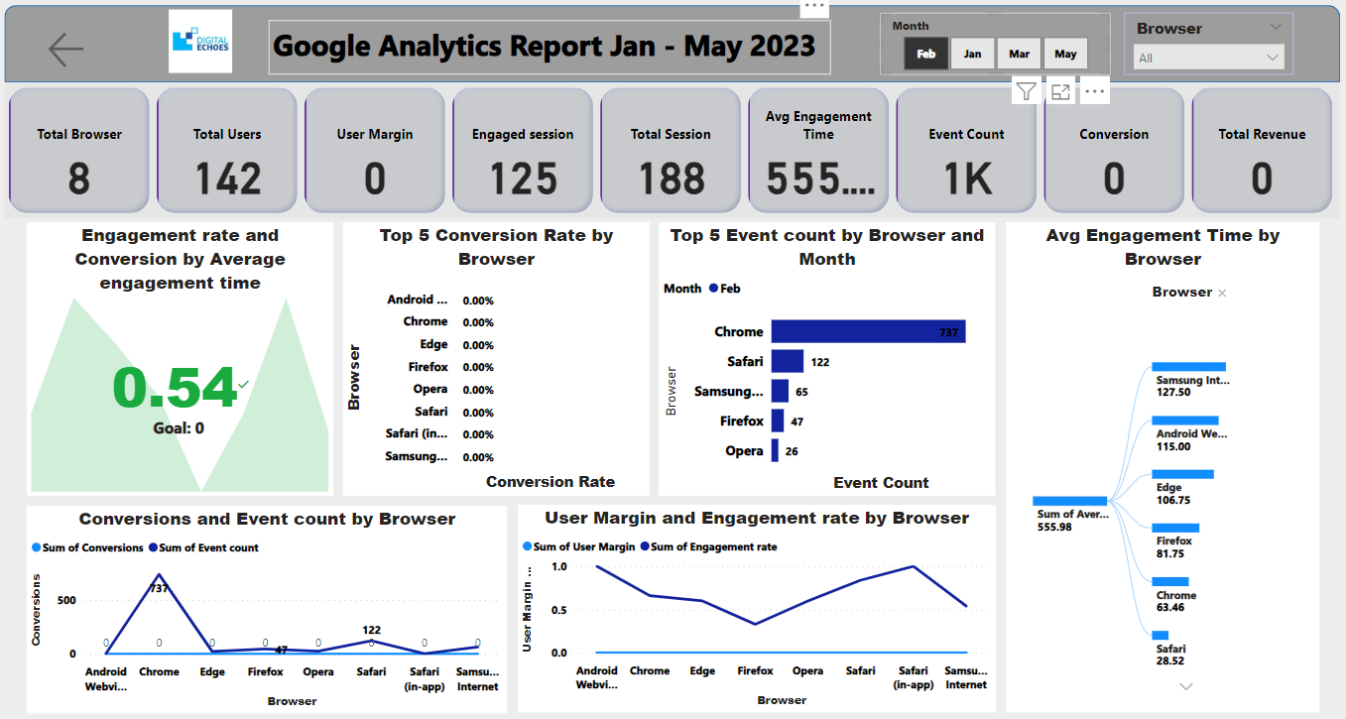

Slide 39
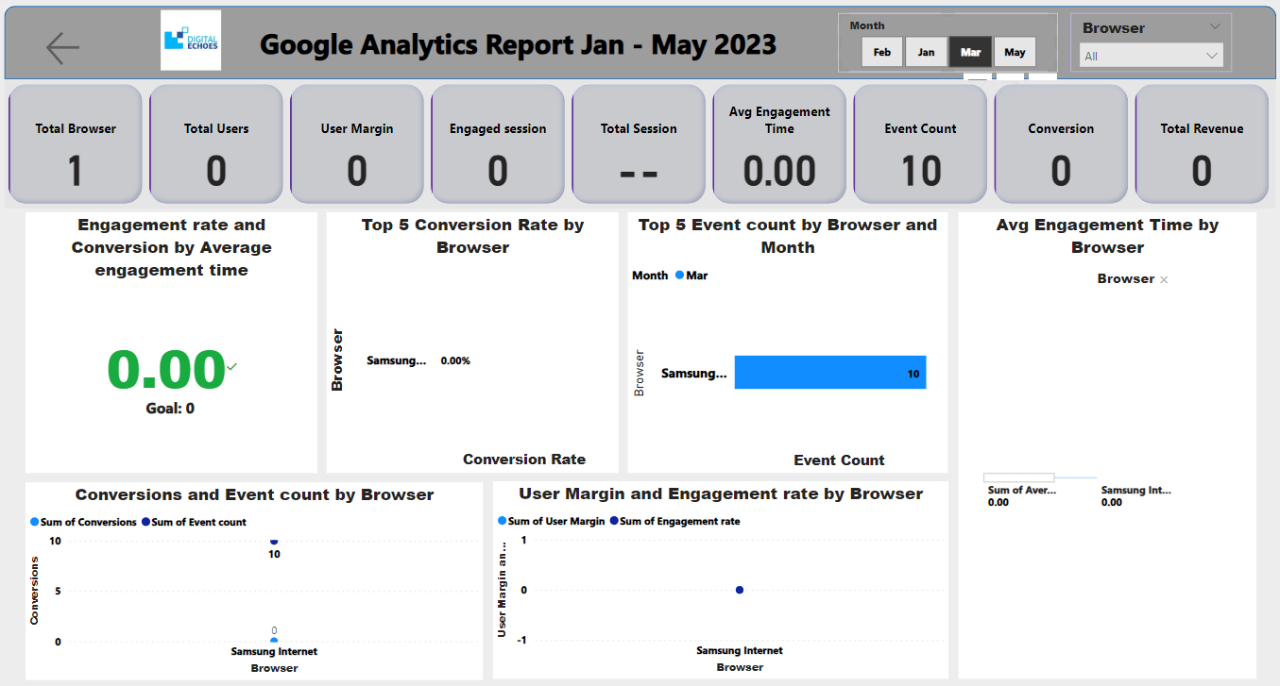

Slide 40
